Slide 1
QA Foundation Change Management Progress
10.4.2019
Prepared for: Delta Dental of California

Slide 2
Agenda
12:00 - 12:40
ART 1/ART 2 High level Summary
ART 1/ART2 team radar comparisons
Quality Maturity level progress
Player/Coach Rollout Progress
End to End testing process outline
Automation Pilot Updates (PI 3 ART 2 teams)
12:40 - 1:00
DevOps Update

Slide 3
ART 1 and 2 Summary
Teams are making progress to Quality Maturity level 3
ART 1 – Teams have had more time to practice and improve maturity
ART 2 – Haven’t had as much time to digest/practice and resource constraints
Common accomplishments
Improvement in Quality Processes and standards
Standardized tooling and reporting
Improvement in ensuring test case coverage
Improvement in Traceability
Automation has a DevOps-first mentality

Slide 4
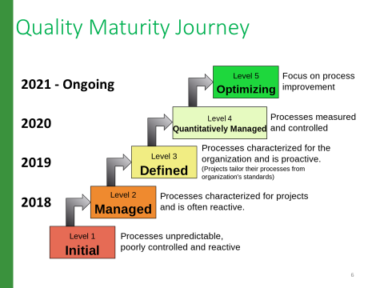
Quality Maturity Levels

Slide 5
Progress Updates for PI 2 ART 1 & 2 teams
Team | Level 3 By 12/31/19
E&B
Sales Platform
ESS
Marketplace
Provider Directory
Group Member Management Online
Group Member Management Batch
Provider management
Provider Experience
Common Challenges:
Resource/Capacity (QE/Automation)
Dual role responsibilities
Increased application ownership
Consistency practicing and adopting best practices and including it as part of sprint estimations (touch base meetings)
Data/Environment
Legend
Yellow – May not reach Maturity level 3 by EOY
Green – Ability to get to Maturity level 3 by EOY

Slide 6
ART 1 – E&B

Slide 7
ART 1 – E&B
Overall QE Process / Manual Test
Test Automation Centric
Opportunities for improvement to next level of Maturity 3 (Defined)
Consistently adding tests into Test management tool
Consistently logging defects for issues
Consistently applying and tracking traceability (User stories, tests, defects)
Prioritizing tests
Refine tests that do not meet standards
Defined regression/smoke test suite
Consistently executing and updating execution within Zephyr
Opportunities for improvement to next level of Maturity 3 (Defined)
Adding Automation QE Capacity – No Automation QE staffed
Potentially shift Shanthi’s workload from Manual to Automation
She has the skillset for automation
Automated tests analysis and relation to tests in Zephyr (DXP/RMB)
Automation test executions updated in Zephyr manually
Report execution results via automation
Automation backlog defined
Analysis of previous work completed
New test cases
Automation tests part of CD – In progress (PI 3)
Jenkins and Saucelabs integration
Code stability and nightly builds
CD integration with DXP
CD integration with RMB
Code Quality with SonarQube
Legend
Green – Consistent Accomplishments
Black – Work in Progress

Slide 8
ART 1 - Sales Platform
Notes:
QE Team is currently adding tests in Zephyr for active sprints
QE Team is currently linking tests to stories for active sprints
Team is continually adding defects and linking them to tests failed
Triage – Reviewing defects daily and assigning priority (Severity field)
Test case Reviews – Going well

Slide 9
ART 1 - Sales Platform
Overall QE Process / Manual Test
Test Automation Centric
Opportunities for improvement to next level of Maturity 3 (Defined)
Improvement around Test case maintenance based on UI changes (PI 1)
Consistently applying and tracking traceability (User stories, tests, defects)
Consistently adding tests into Test management tool
Consistently executing and updating execution within Zephyr
Consistently logging defects for issues
Defined regression suite – In progress (PI 3)
hCentive – In Progress
PAD – Lower priority (lower user base)
Prioritizing tests – Needs work but in progress
Opportunities for improvement to next level of Maturity 3 (Defined)
Automated tests analysis and relation to tests in Zephyr– In progress (PI 3)
Automation test executions updated in Zephyr manually
Report execution results via automation
Automation backlog defined
Analysis of previous work completed
New/Existing test cases
Automation tests part of CD – In progress (PI 3)
Jenkins and Saucelabs integration
Code stability and nightly builds
CD integration with Hcentive
CD integration with PAD
Code Quality with SonarQube
Notes:
QE Team is currently adding tests in Zephyr for active sprints
QE Team is currently linking tests to stories for active sprints
Team is continually adding defects and linking them to tests failed
Triage – Reviewing defects daily and assigning priority (Severity field)
Test case Reviews – Going well

Slide 10
ART 1 - ESS
Notes:
QE Team is currently adding tests in Zephyr for active sprints
QE Team is currently linking tests to stories for active sprints
Team is continually adding defects and linking them to tests failed
Triage – Reviewing defects daily and assigning priority (Severity field)
Test case Reviews – Going well

Slide 11
ART 1 - ESS
Overall QE Process / Manual Test
Test Automation Centric
Opportunities for improvement to next level of Maturity 3 (Defined)
Refine tests that do not meet standards
Consistently logging defects for issues
Defined regression/smoke test suite
Prioritizing all tests
Consistently Applying/tracking traceability (User stories, tests, defects)
Consistently adding tests into Test management tool
still had tests being attached to user stories
Opportunities for improvement to next level of Maturity 3 (Defined)
Migrating older but applicable tests and mapping analysis with Automation tests
Automation test executions updated in Zephyr manually
Report execution results via automation
Automation backlog defined
In-sprint automation
Framework features in backlog
Automation tests part of CD – In progress
Smoke Tests defined
Still work on integration with Jenkins and Saucelabs
Code stability and nightly builds
Code Quality with SonarQube
Notes:
QE Team is currently adding tests in Zephyr for active sprints
QE Team is currently linking tests to stories for active sprints
Team is continually adding defects and linking them to tests failed
Triage – Reviewing defects daily and assigning priority (Severity field)
Test case Reviews – Going well

Slide 12
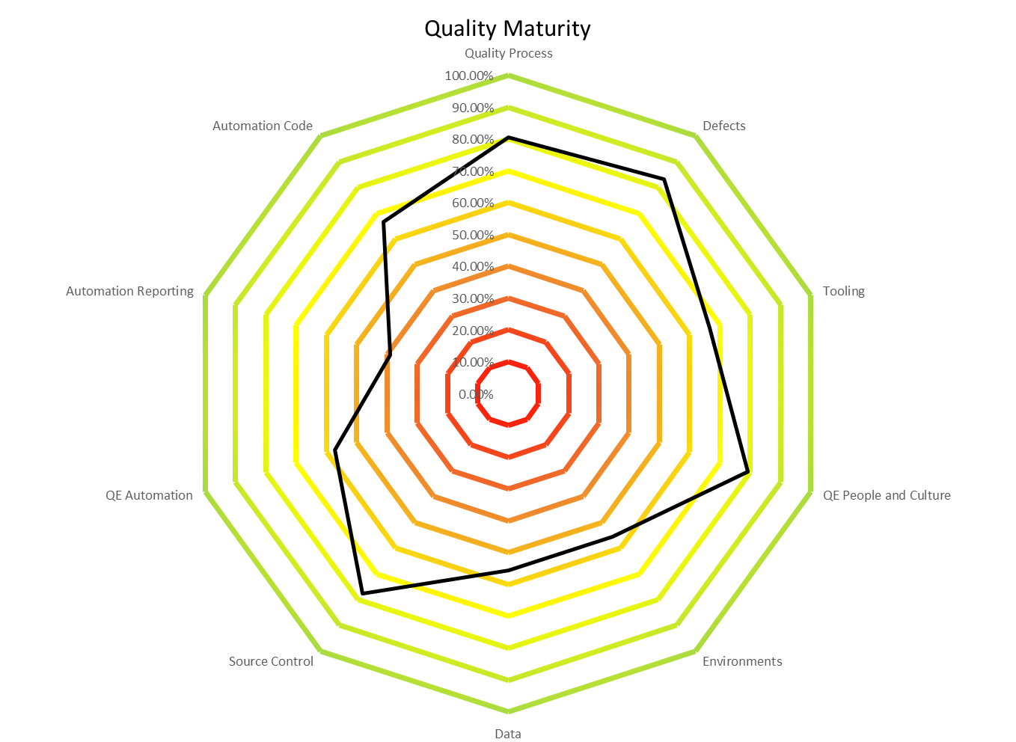
ART 1 - Marketplace
Notes:
QE Team is currently adding tests in Zephyr for active sprints
QE Team is currently linking tests to stories for active sprints
Team is continually adding defects and linking them to tests failed
Triage – Reviewing defects daily and assigning priority (Severity field)
Test case Reviews – Going well

Slide 13
ART 1 - Marketplace
Overall QE Process / Manual Test
Test Automation Centric
Opportunities for improvement to next level of Maturity 3 (Defined)
Consistently adding tests into Test management tool
Consistently logging defects for issues
Consistently tracking traceability (User stories, tests, defects)
Prioritizing tests
Defined regression/smoke test suite
Better communication between SDA/Marketplace teams in terms of API test coverage
Consistently executing and updating execution within Zephyr
Opportunities for improvement to next level of Maturity 3 (Defined)
Automated tests analysis and relation to tests in Zephyr (% of Automated vs Manual Tests)
Automation and Manual team in alignment
Automation test executions updated in Zephyr manually
Report execution results via automation
Automation backlog defined
In sprint automation
Framework Feature need to be defined
Automation tests part of CD
Jenkins and Saucelabs integration and parallel runs
Code stability and nightly builds
Not integration with application CD
Code Quality with SonarQube
Scans occur within Jenkins Pipeline
Project available on SonarQube site
Notes:
QE Team is currently adding tests in Zephyr for active sprints
QE Team is currently linking tests to stories for active sprints
Team is continually adding defects and linking them to tests failed
Triage – Reviewing defects daily and assigning priority (Severity field)
Test case Reviews – Going well
Automation test executions updated in Zephyr manually
Report execution results via automation

Slide 14
ART 1 – Provider Directory
Notes:
QE Team is currently adding tests in Zephyr for active sprints
QE Team is currently linking tests to stories for active sprints
Team is continually adding defects and linking them to tests failed
Triage – Reviewing defects daily and assigning priority (Severity field)
Test case Reviews – Going well

Slide 15
ART 1 – Provider Directory
Overall QE Process / Manual Test
Test Automation Centric
Opportunities for improvement to next level of Maturity 3 (Defined)
Consistently adding tests into Test management tool
Communication for in sprint testing between manual/automation QE
Continue defining regression/smoke test suite
Consistently logging defects for issues
Consistently tracking traceability (User stories, tests, defects)
Prioritizing tests
Consistently executing and updating execution within Zephyr
Opportunities for improvement to next level of Maturity 3 (Defined)
Automated tests analysis and relation to tests in Zephyr
Automation Tests are in Zephyr
Automation test executions updated in Zephyr manually
Report execution results via automation
Automation backlog defined
In sprint automation tests added to backlog as needed
Framework Feature built and added to backlog as needed
Automation tests part of CD
Jenkins and Saucelabs integration
Code stability on checkin
Need Nightly and parallel runs
Not integration with application CD
Code Quality with SonarQube
Scans occur within Jenkins Pipeline
Project available on SonarQube site
Notes:
QE Team is currently adding tests in Zephyr for active sprints
QE Team is currently linking tests to stories for active sprints
Team is continually adding defects and linking them to tests failed
Triage – Reviewing defects daily and assigning priority (Severity field)
Test case Reviews – Going well

Slide 16
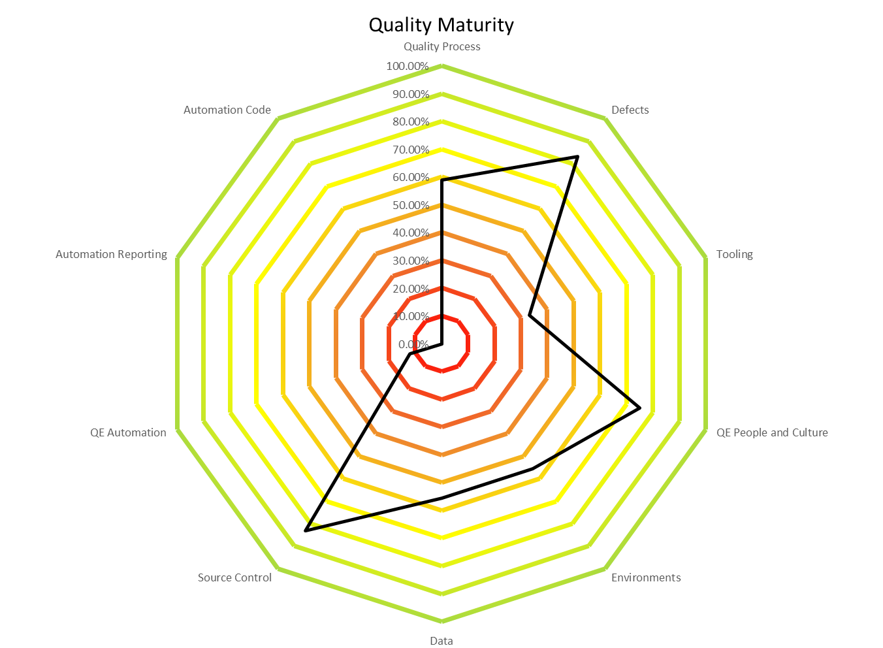

ART 2 – Group Member Management - Batch
Notes:
QE Team is currently adding tests in Zephyr for active sprints
QE Team is currently linking tests to stories for active sprints
Team is continually adding defects and linking them to tests failed
Triage – Reviewing defects daily and assigning priority (Severity field)
Test case Reviews – Going well

Slide 17
ART 2 – Group Member Management - Batch
Overall QE Process / Manual Test
Test Automation Centric
Opportunities for improvement to next level of Maturity 3 (Defined)
Consistently adding tests into Test management tool
Refine and update tests that do not meet standards
Defined regression suite
Test case reviews
Prioritizing all tests
Communication for in sprint testing between manual/automation QE
Consistently logging defects for issues
Consistently tracking traceability (User stories, tests, defects)
Opportunities for improvement to next level of Maturity 3 (Defined)
Adding Automation QE Capacity – No Automation QE staffed
Automated tests analysis and relation to tests in Zephyr (% of Automated vs Manual Tests)
Automation and Manual team in alignment
Automation test executions from Jenkins manually
Report execution results via automation
Automation Tests are in Zephyr
Automation test executions updated in Zephyr manually
Automation backlog defined
Framework feature need to be defined
In Sprint automation
Automation tests part of CD – In progress
Smoke Tests defined
Still work on integration with Jenkins and Saucelabs
Jenkins integration and parallel runs
Code stability and nightly builds
No integration with application CD
Notes:
QE Team is currently adding tests in Zephyr for active sprints
QE Team is currently linking tests to stories for active sprints
Team is continually adding defects and linking them to tests failed
Triage – Reviewing defects daily and assigning priority (Severity field)
Test case Reviews – Going well

Slide 18
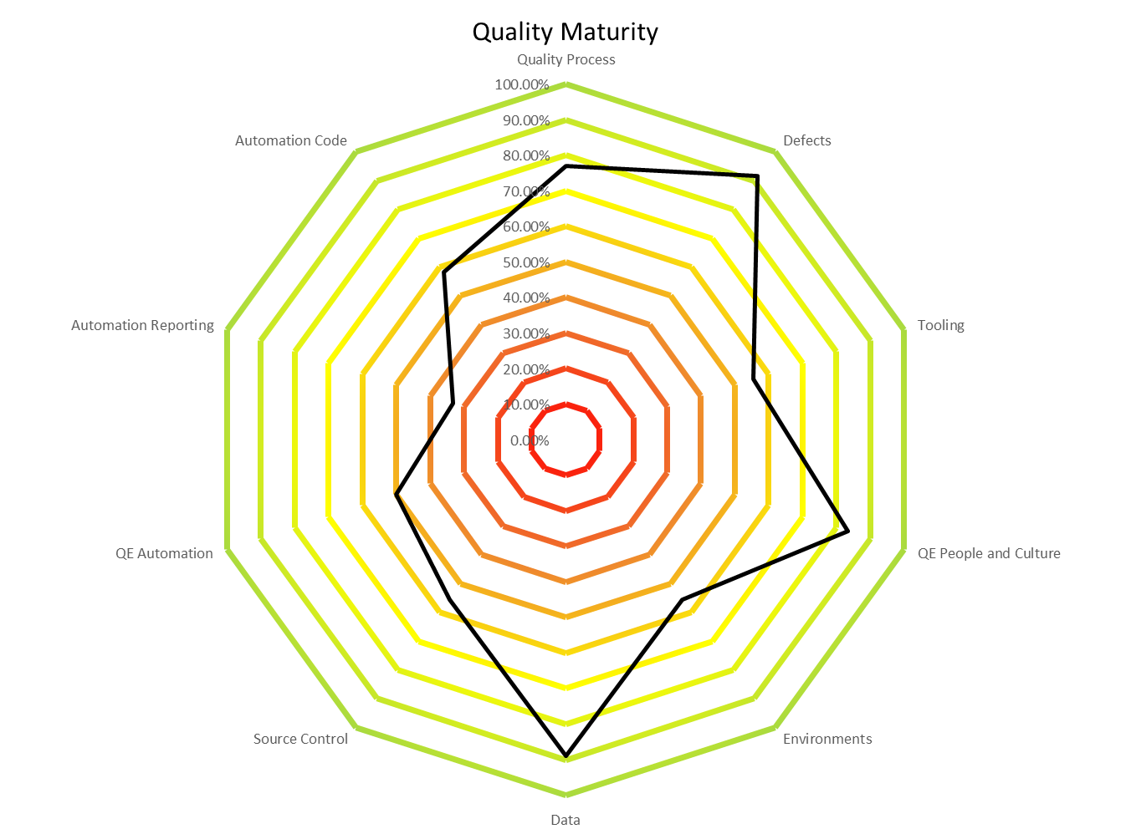
ART 2 –Group Member Management - Online
Notes:
QE Team is currently adding tests in Zephyr for active sprints
QE Team is currently linking tests to stories for active sprints
Team is continually adding defects and linking them to tests failed
Triage – Reviewing defects daily and assigning priority (Severity field)
Test case Reviews – Going well

Slide 19
ART 2 –Group Member Management - Online
Overall QE Process / Manual Test
Test Automation Centric
Opportunities for improvement to next level of Maturity 3 (Defined)
Consistently adding tests into Test management tool
Refine and update tests that do not meet standards
Defined regression suite
Test case reviews
Prioritizing all tests
Communication for in sprint testing between manual/automation QE
Consistently logging defects for issues
Consistently tracking traceability (User stories, tests, defects)
Opportunities for improvement to next level of Maturity 3 (Defined)
Adding Automation QE Capacity – No Automation QE staffed
Automated tests analysis and relation to tests in Zephyr (% of Automated vs Manual Tests)
Automation and Manual team in alignment
Automation test executions from Jenkins manually
Report execution results via automation
Automation Tests are in Zephyr
Automation test executions updated in Zephyr manually
Automation backlog defined
Framework feature need to be defined
In Sprint automation
Automation tests part of CD – In progress
Smoke Tests defined
Still work on integration with Jenkins and Saucelabs
Jenkins integration and parallel runs
Code stability and nightly builds
No integration with application CD
Notes:
QE Team is currently adding tests in Zephyr for active sprints
QE Team is currently linking tests to stories for active sprints
Team is continually adding defects and linking them to tests failed
Triage – Reviewing defects daily and assigning priority (Severity field)
Test case Reviews – Going well

Slide 20
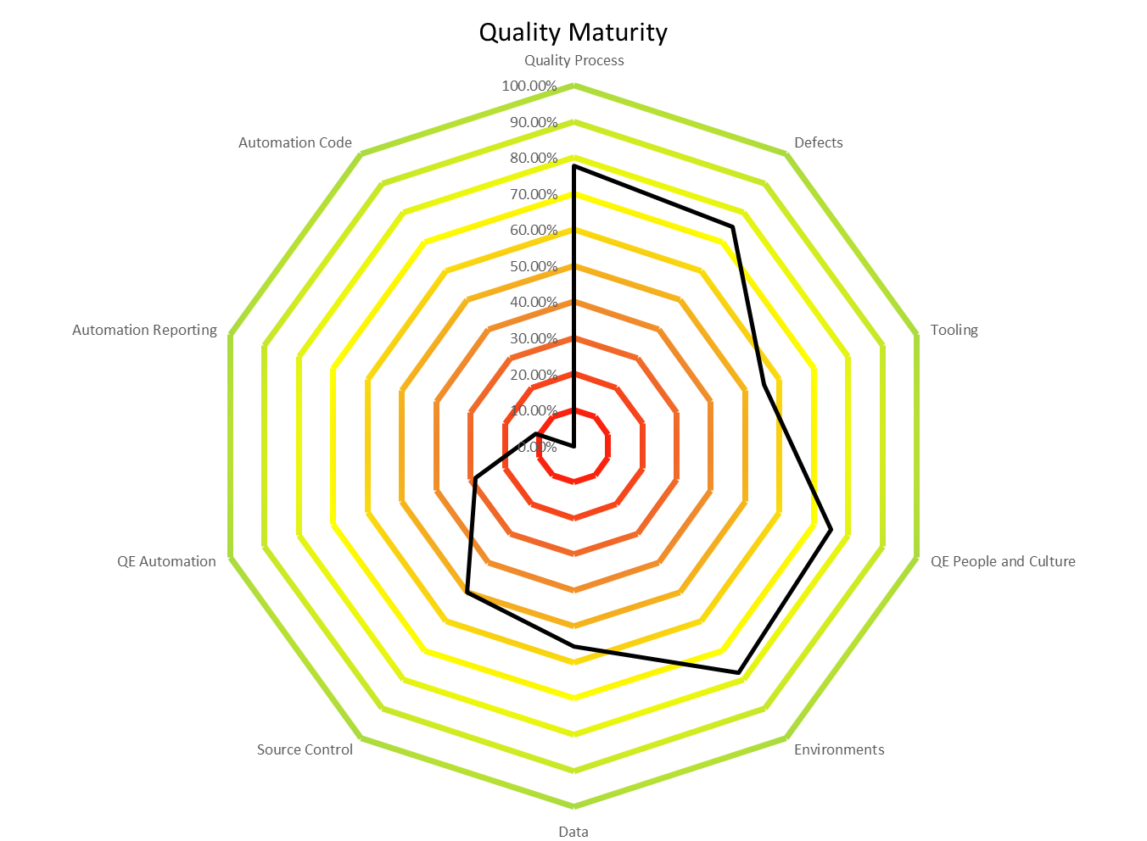
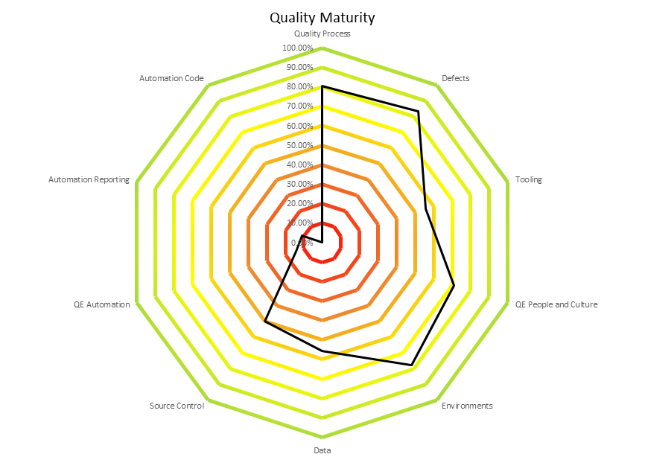
ART 2 – Provider Management
Notes:
QE Team is currently adding tests in Zephyr for active sprints
QE Team is currently linking tests to stories for active sprints
Team is continually adding defects and linking them to tests failed
Triage – Reviewing defects daily and assigning priority (Severity field)
Test case Reviews – Going well

Slide 21
ART 2 – Provider Management
Overall QE Process / Manual Test
Test Automation Centric
Opportunities for improvement to next level of Maturity 3 (Defined)
Communication for in sprint testing between manual/automation QE
Define regression suite
Consistently logging defects for issues
Consistently tracking traceability (User stories, tests, defects)
Test case reviews
Adding Automation QE Capacity
Add QE Manual Capacity
Opportunities for improvement to next level of Maturity 3 (Defined)
Automated tests analysis and relation to tests in Zephyr (% of Automated vs Manual Tests)
Automation and Manual team in alignment
Automation test executions updated in Zephyr manually
Report execution results via automation
Automation backlog defined
In sprint automation
Framework Feature being defined
Reviewing P360 tool for automation opportunities
Automation tests part of CD
Jenkins and Saucelabs integration and parallel runs
Code stability and nightly builds
Not integration with application CD
Code Quality with SonarQube
Scans occur within Jenkins Pipeline
Project available on SonarQube site
Notes:
QE Team is currently adding tests in Zephyr for active sprints
QE Team is currently linking tests to stories for active sprints
Team is continually adding defects and linking them to tests failed
Triage – Reviewing defects daily and assigning priority (Severity field)
Test case Reviews – Going well

Slide 22
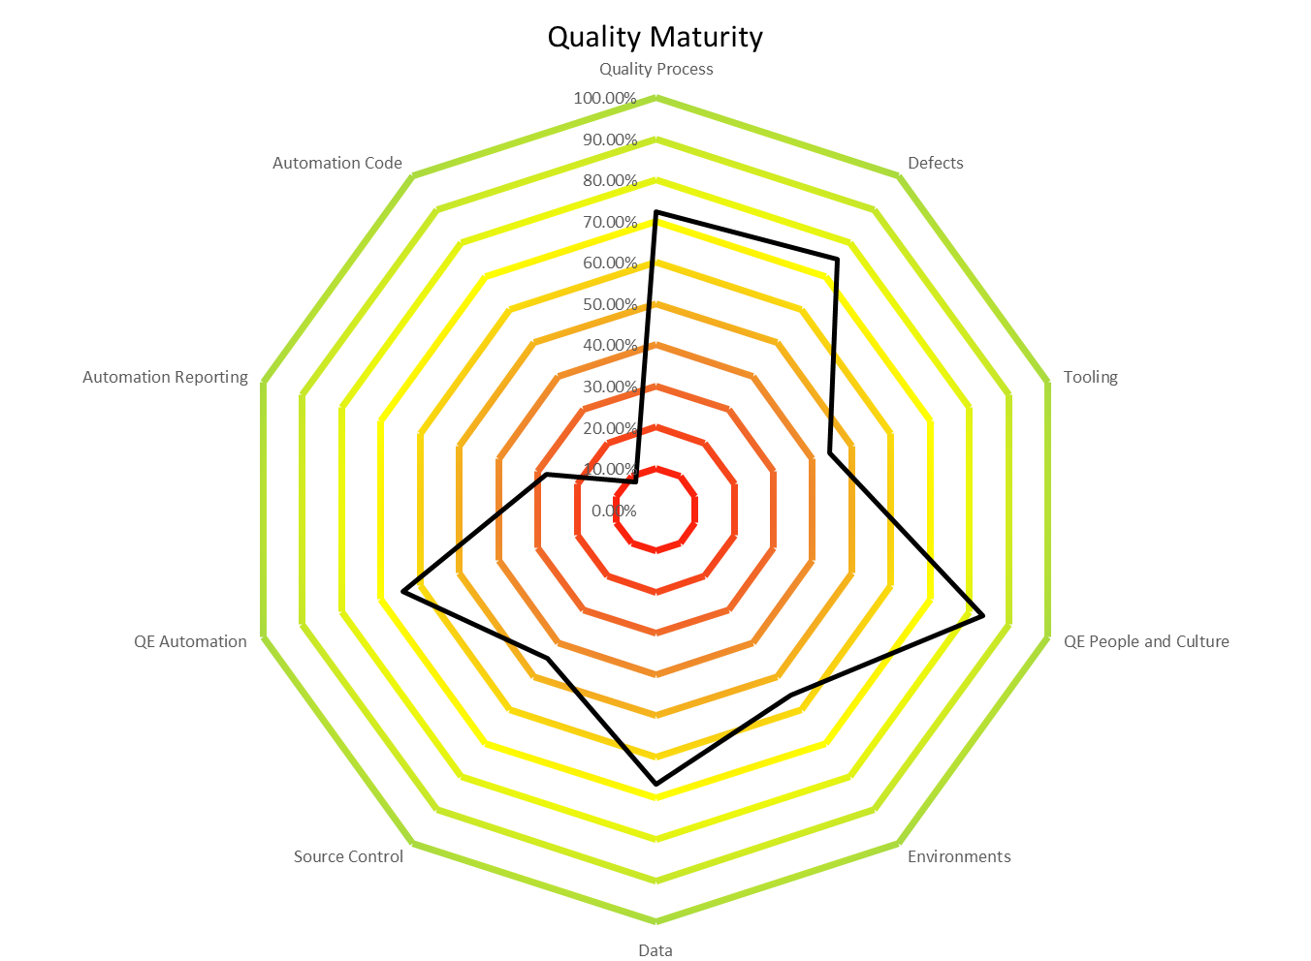
ART 2 –Provider Experience
Notes:
QE Team is currently adding tests in Zephyr for active sprints
QE Team is currently linking tests to stories for active sprints
Team is continually adding defects and linking them to tests failed
Triage – Reviewing defects daily and assigning priority (Severity field)
Test case Reviews – Going well

Slide 23
ART 2 –Provider Experience
Overall QE Process / Manual Test
Test Automation Centric
Opportunities for improvement to next level of Maturity 3 (Defined)
Communication for in sprint testing between manual/automation QE
Consistently logging defects for issues
Consistently tracking traceability (User stories, tests, defects)
Prioritizing all tests
Defining Regression suite
Test case reviews
Add QE Capacity
Opportunities for improvement to next level of Maturity 3 (Defined)
Automated tests analysis and relation to tests in Zephyr (% of Automated vs Manual Tests)
Automation and Manual team in alignment
Automation test executions updated in Zephyr manually
Report execution results via automation
Automation backlog defined
In sprint automation
Framework Feature being defined
Automation tests part of CD
Jenkins and Saucelabs integration and parallel runs
Code stability and nightly builds
No integration with application CD
Code Quality with SonarQube
Scans occur within Jenkins Pipeline
Project available on SonarQube site
Notes:
QE Team is currently adding tests in Zephyr for active sprints
QE Team is currently linking tests to stories for active sprints
Team is continually adding defects and linking them to tests failed
Triage – Reviewing defects daily and assigning priority (Severity field)
Test case Reviews – Going well

Slide 24
Player/Coach High Level Rollout Plan – PI 3
Sprint 1
Sprint 2
Sprint 3
Sprint 4
Sprint 5
Sprint 6
PI 4
ART 2 SAFe ~ 4 weeks
Traceability
Test case and defect standardization
Test prioritization
Test Case Maintenance
Test Management tool use
ART 2 SAFe ~ 4 weeks
Test Management tool training/ documentation
QE reporting process/tools
PI3 QA Innovation Day
ART 2 SAFe ~ 4 weeks
Automation Tool ecosystem
Automation Traceability
Automation estimation/tracking/maintenance
ART 2 SAFe ~ 4 weeks
Automation deployment integration
Automation process to identify test failure vs application failure
Code quality/standards/reviews
Legend
QE Lead
Automation Architect
Phase I
Phase II
On-going governance, training, retrospectives, collection of test metrics
ART1 – 100%
ART2 – 100%
PI 3 ART2– 100%
ART1 – 100%
ART2 – 100%
PI 3 ART2– 10%

Slide 25
End to End Testing – Update
Phase 1: End-To-End Test Scope Definition - COMPLETE
Discussions with App Directors, Product Managers and Owners and Scrum Masters
Support/engage UAT and/or business partner testing
Phase 2 (Thru Mid-October)
Document Process: Who, What and When for Test Design, Development, Execution and Maintenance
Including Coverage Metrics and Automation strategies
Socializing Process with App Directors, Product Managers and Owners and Scrum Masters
Phase 3 (Mid-late October)
Training of affected roles (QE Leads, Testers and/or BA’s)
Defined responsibilities
Work through PI4 Pre-Planning process
Notes:
Slide

Slide 26
Decisions to Make
Who is responsible for various steps in the process
Personas and Scenarios Pre-PI Planning
Story generation and assignment
Test Case Creation/Execution
Existing Capability Coverage
Catch up
Evolve

Slide 27
PI 3 – Automation Pilot Updates
Group Billing Management
Automation pilot in progress
EBD / EP
Automation pilot in progress
Customer Onboarding/CRM Growth
Onboarded new QE automation resource
Doc Management
Automation tool evaluation in progress
EIVR
Automation pilot for eIVRConsole in progress

Slide 28
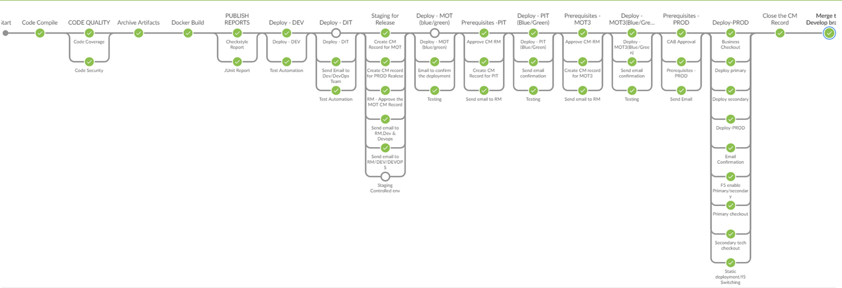
Vision and DevOps Pipeline
Standardization
Faster
Better
Cheaper

Slide 29
DevOps/Test Automation Integrations
There are several areas where DevOps enables Test Automation
Source Control (GitHub)
Code Quality (SonarQube)
Continuous Integration (Jenkins)

Slide 30
Supporting DevOps Through Test Automation
The DevOps pipeline is constrained by manual processes
Automating gateway testing (smoke/checkout testing) enables velocity
Investing in test automation empowers the DevOps pipeline

Slide 31
Next Steps
Continue tracking progress DDC QE Lead
Continue driving standards and best practices for all teams on all trains
Continue support All teams
Continue Phase 2 for ART 2 teams
Continue End to End testing outline

Slide 32
Appendix

Slide 33
Standardization Survey and Scoring
Standardization Survey Link :
http://techportal/sites/devops/Lists/Test%20Dev%20Survey/Quick%20View.aspx#InplviewHash7d17368f-a167-437a-80d9-f50041bc1eb0=ShowInGrid%3DTrue
Detailed write-up and Scoring Criteria Link:
https://atlassian/confluence/pages/viewpage.action?pageId=58012162

